Slide 1

Project Space Mission using Data Science
Siddhant Shetty
10th April 2024

Slide 2

Outline
Executive Summary
Introduction
Methodology
Result
Conclusion

Slide 3
Executive Summary
Data Collection using API
Data Collection using web Scraping
Data Wrangling
Exploratory Data Analysis using SQL
Exploratory Data Analysis using Visualization
Interactive Visualizations
Predictive Analytics and Results

Slide 4
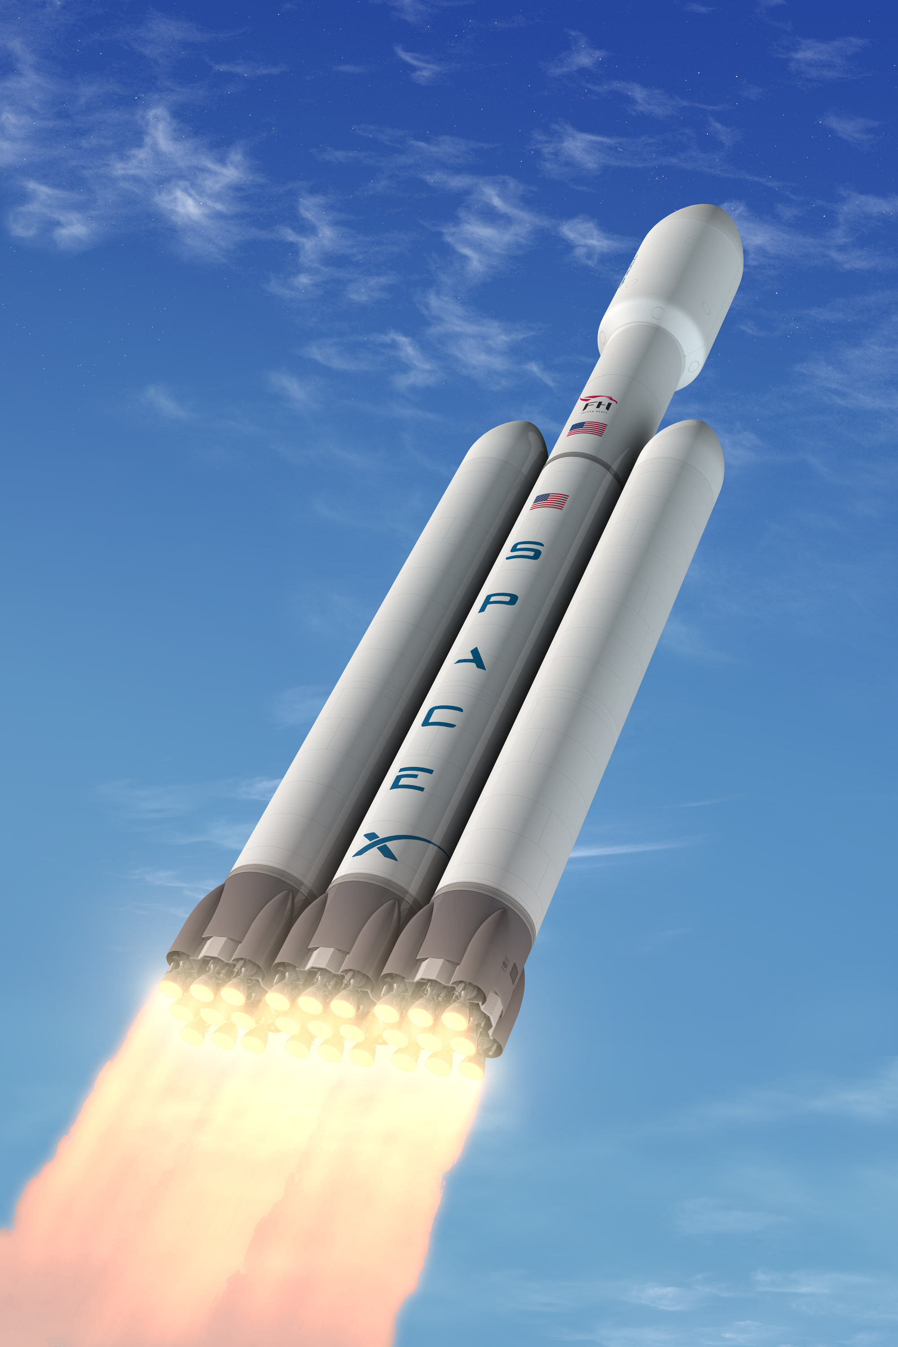
Project Background and Context
Introduction
Space X advertises Falcon 9 rocket launches on its website with a cost of 62 million dollars. Other providers cost upward of 165 million dollars each, much of the savings is because Space X can reuse the first stage.
Therefore, if we can determine if the first stage will land, we can determine the cost of a launch. This information can be used if an alternate company wants to bid against space X for a rocket launch.
The goal of this project is to create a machine learning pipeline to predict if the first stage will land successfully.
This info. can be used by another company who wants top bid against SpaceX for a rocket launch.

Slide 5

Methodology
Data Collection using SpaceX API and web scraping from Wikipedia
Data Wrangling on the collected data
EDA using SQL and Visualizations
Interactive Analytics
Performing Predictive Analytics using classification models

Slide 6
Data Collection
The data is collected through Wikipedia as well as the SpaceX website.
From the SpaceX website, data is collected using get request
The response is coded as a json file that is converted into a pandas data frame using json_normalize
Data is then checked for missing values and cleaned.
The other data is web scraped from Wikipedia using beautiful soup
The html table is parsed to extract launch records and convert into pandas dataframe.

Slide 7
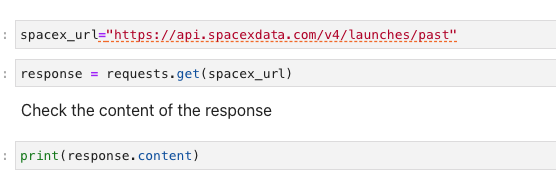
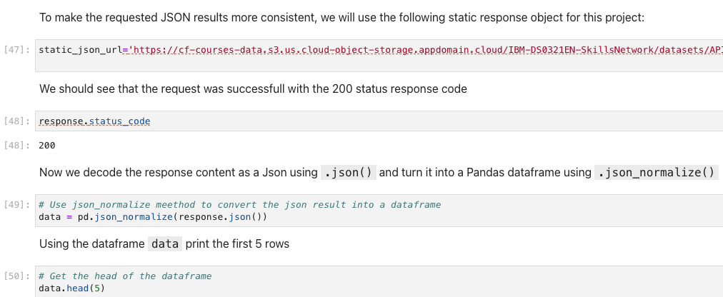
Data Collection – SpaceX API
Get request is used on the SpaceX API to collect data, clean the data and do data wrangling.

Slide 8
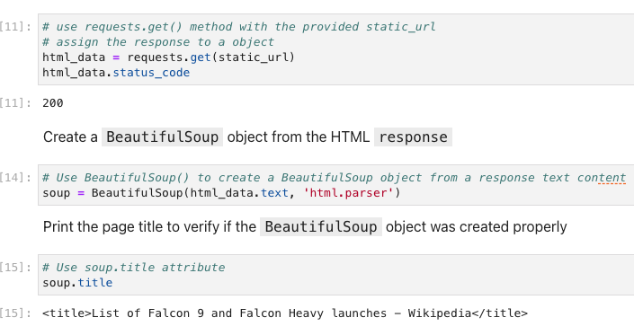
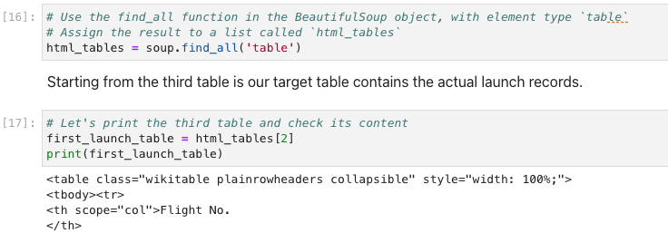
Data Collection – Web scaping
Web scraping is used to scrape launch records of falcon9 rocket with beautiful soup
Html table is parsed and converted. To a pandas data frame.
Further, wrangling is done on the data. This can be seen on the notebook uploaded on the github.

Slide 9
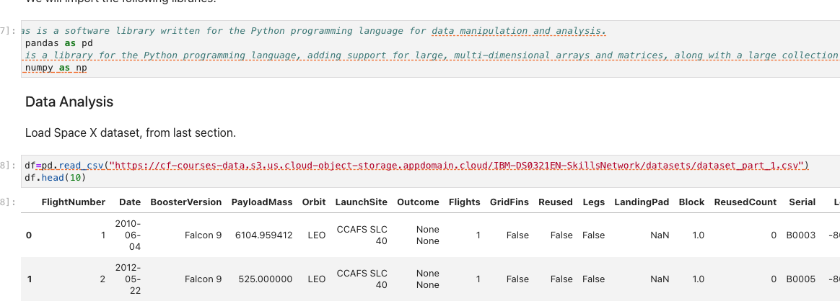
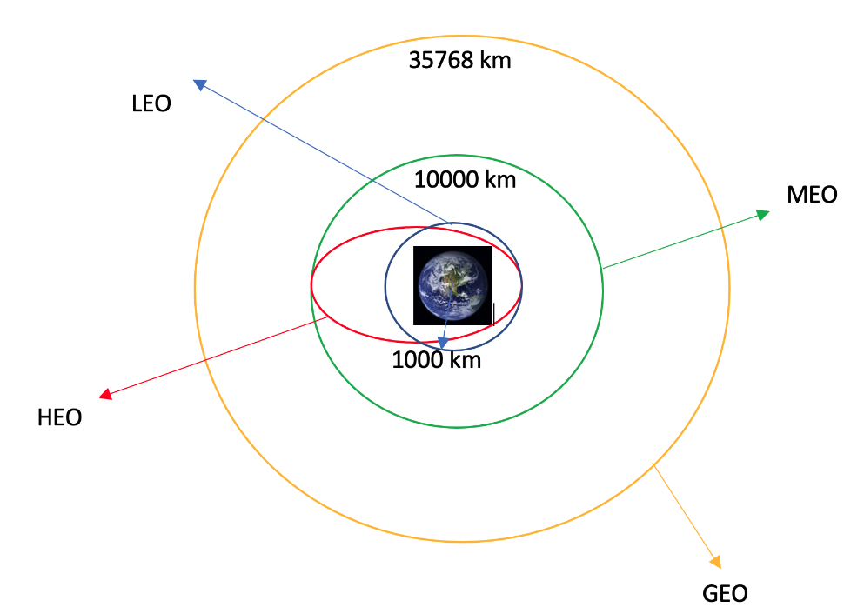
Data Wrangling
Exploratory data analysis is performed on the data.
Number of Launches on each site and number/occurrence of each orbits are calculated.
Landing outcome label is created and results are exported to csv.

Slide 10
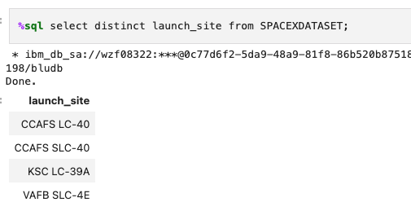
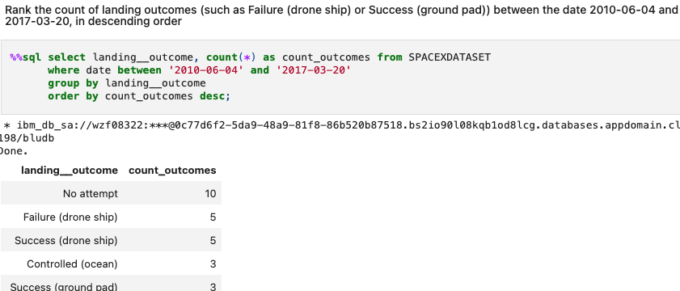
EDA with SQL
The SpaceX dataset is loaded to IbmDB2 database. A connection is made between the jupyter notebook and SQL database.
SQL queries are further written to find names of unique launches, total payload mass, no. of successful and failure mission outcomes.
Distinct keyword used to show only unique launch sites.
Landing Outcomes during a particular period.

Slide 11
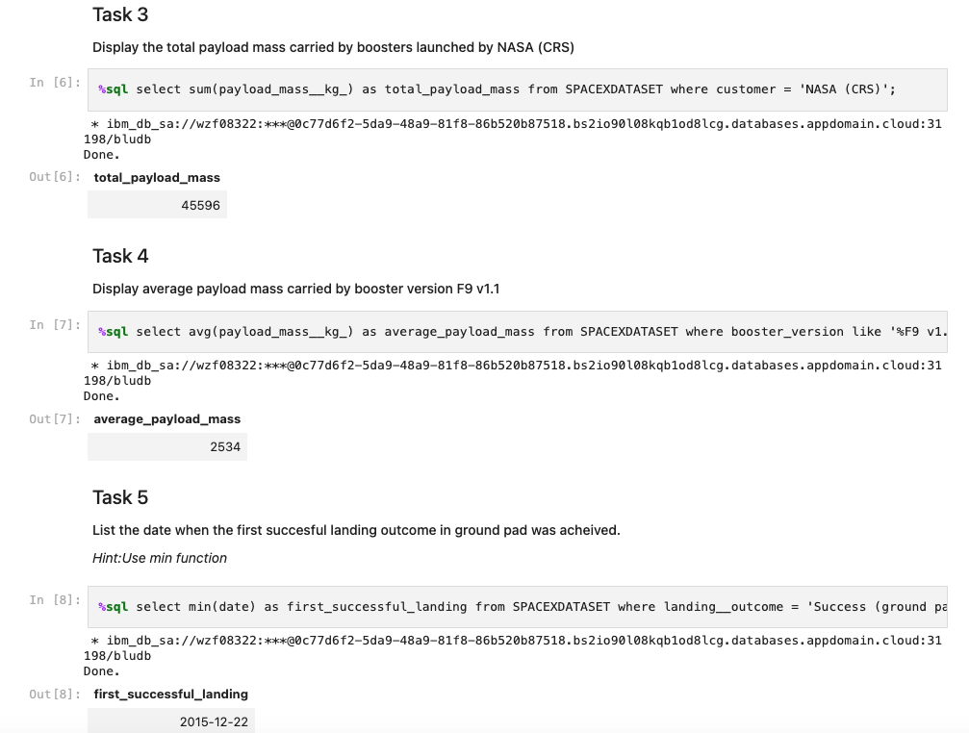
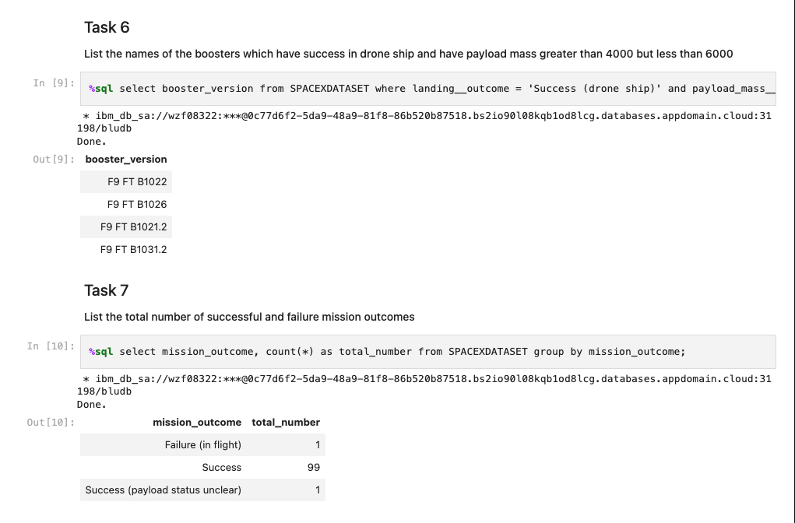
More SQL queries

Slide 12
EDA with Visualization
Data is explored by visualizing the relationship between flight number and site launch, payload and launch site, flight number and orbit, success rate of each orbit type.
The following visualization results are shared in the upcoming slides.

Slide 13
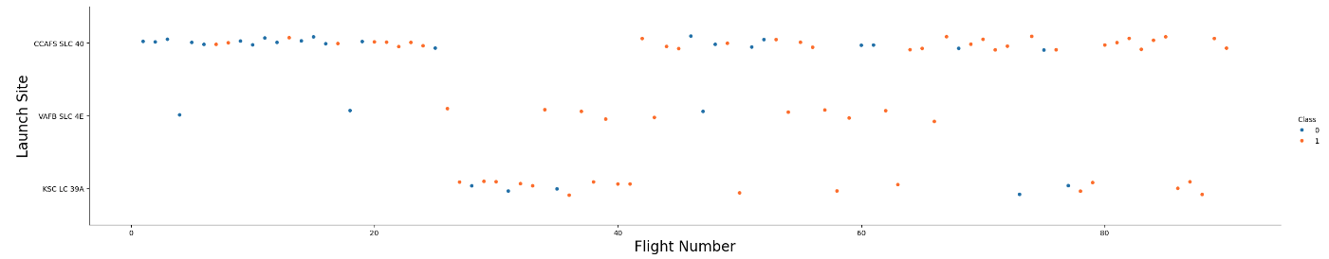
Flight number vs Launch Site
From the plot it is clearly evident. Especially for CCAFS SLC 40, more the flight number , more the launch site success rate. It stands true for the other two launch sites as. Well.

Slide 14
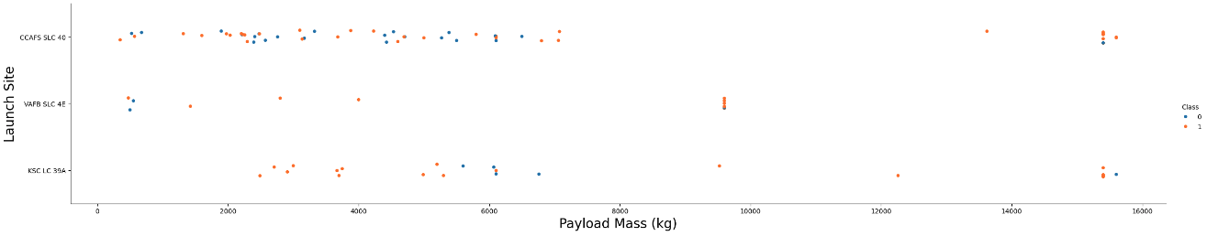
Payload vs Launch Site
The greater the mass for launch site CCAFS SLC 40, the higher the success rate of the rocket.

Slide 15
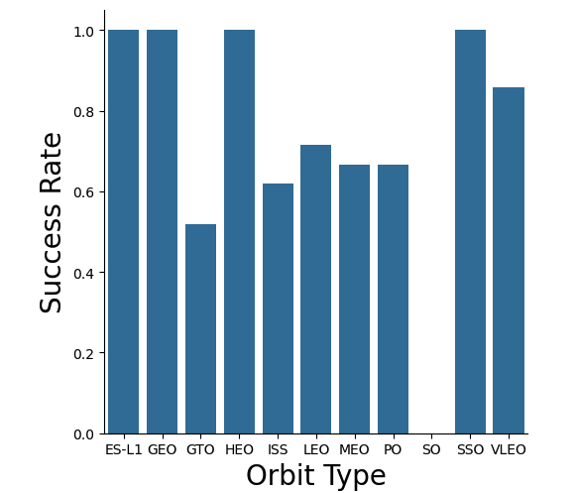
Success Rate vs Orbit Type
From the plot, we can see, SSO, ES-L1, GEO and HEO have. The most success rate.

Slide 16
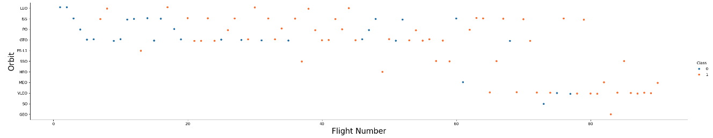
Flight Number. Vs orbit Type
The success is related to the number of flights in the LEO orbit. There is no relation for GTO orbit.

Slide 17
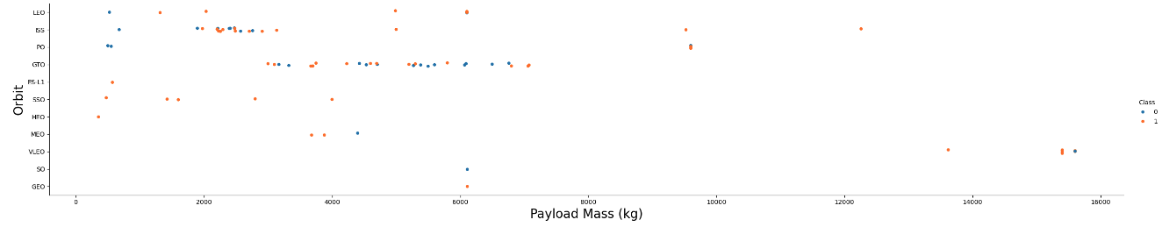
Payload vs orbit
The successful landings. Are for PO,LEO, and ISS orbits.

Slide 18
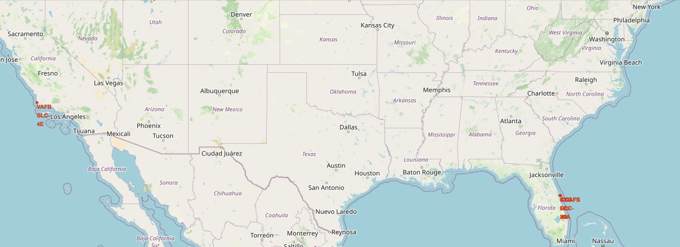
Interactive Analytics using Folium
The only two launch sites of SpaceX in the world.

Slide 19
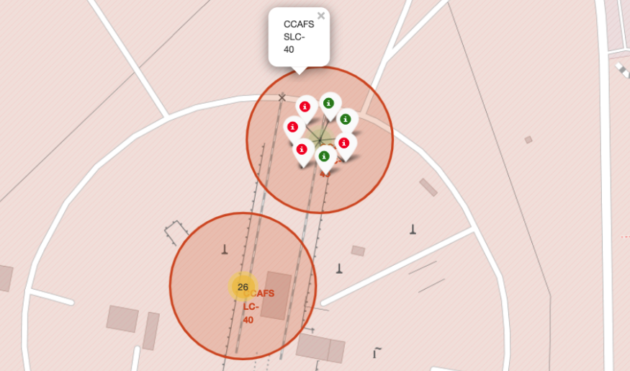
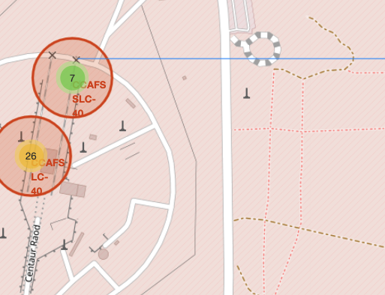
Launch Sites with color labels

Slide 20
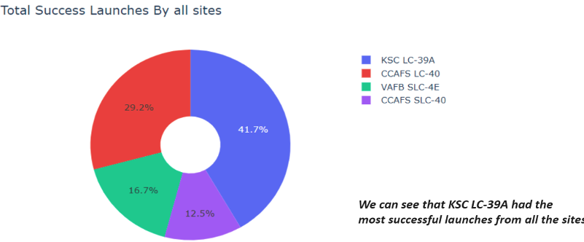
Success Achieved by Each launch site

Slide 21

Predictive Analysis

Slide 22
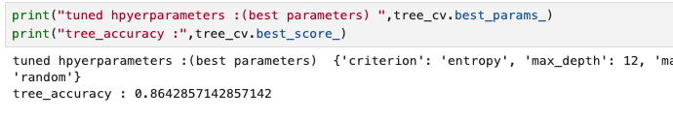
Classification Accuracy
The decision tree classifier is the model with highest classification accuracy

Slide 23
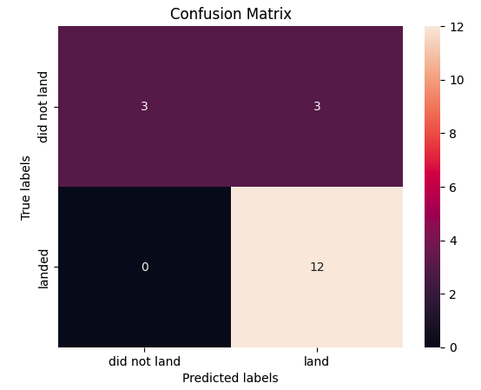
Confusion Matrix
The matrix for the decision tree can distinguish between different classes.
Major problem is the false positives.

Slide 24
Some Conclusions
Larger the flight amount at a launch site, greater the success rate at a launch site.
Launch success rate started to increase from 2013-2020.
Orbits ES-L1, GEO, HEO, SSO, VLEO have the most success rates.
KSC LC-39A has the most successful launches of any sites.
Decision Tree classifier is the best machine learning algorithm in this case.

